Slide 1
Annotating intonation units in the Taiwan Mandarin Corpus
Ryan Ka Yau Lai
University of California, Santa Barbara

Slide 2
Intonation units

Slide 3

What’s an IU?
A problem of assigning boundaries to speech
Empirically driven (not interested in lab-grown speech) (vs. intonation phrase)

Slide 4

What’s an IU?
‘Subjective’ cue trading needed – not based on a single cue
Pauses: Not as important as you might think
(Phonetic cues only – not syntactic or lexical cues!)

Slide 5

What’s an IU?
From the speaker’s perspective: a unit of planning
From the both parties’ perspectives: the focus of consciousness at any time

Slide 6

When did you get into a living relationship with those artists in Paris at what age with artists in Paris yes uhm I went to study art in Paris a little bit uh but I really didn’t meet any answers and to answer your question the way I think you would like it answered I was twenty-three In New York
(SBC055 – The Mada of Dada)

Slide 7
Perrot: When did you get into a living relationship with those artists in Paris
At what age
Wood: with artists in Paris
Perrot: Yes
Wood: Uhm
I went to study art in Paris
A little bit
Uh But I really didn’t meet any answers
And to answer your question the way I think you would like it answered
I was twenty-three
In New York

Slide 8
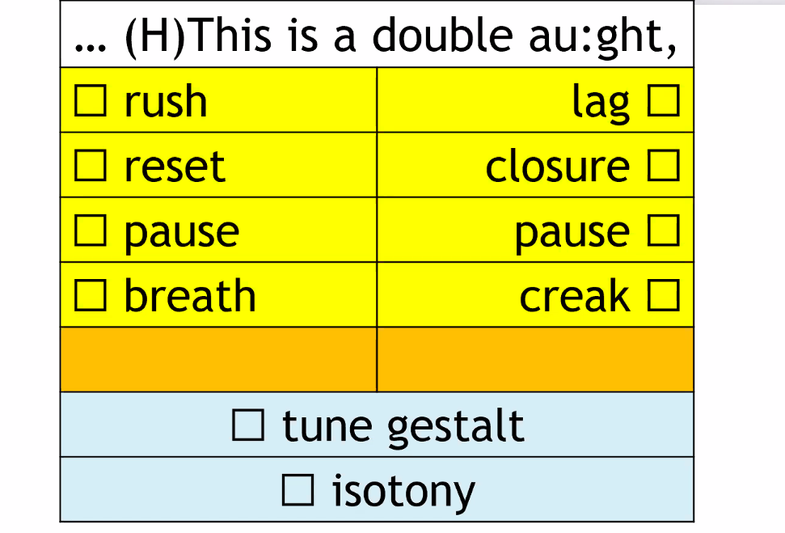
Um with our other penguins uh we brought them over from Scotland and as it turned out in the quarantine period that they had that a vi- I should say a fungus okay this aspergillosis fungus had come to fruition and we had lost you know a good portion of penguins so okay now it’s time to consider replacing these penguins how do we wanna go about doing that
(SBC039 – Pretty Busy Bird)

Slide 9
Um
With our other penguins
uh
We brought them over from Scotland
and
As it turned out
In the quarantine period that they had
That
A vi-
I should say a fungus
Okay this Aspergillosis fungus
Had come to fruition
And
we had lost
You know a good portion of penguins
So
Okay
Now it’s time to consider replacing these penguins
How do we wanna go about doing that
Notes:
Rush, slowdown, breath – with our other penguins
Now it’s time to consider replacing these penguins (RESET) How do we wanna go about doing that
A vi – closure, pause
Isotony – I should say a fungus, okay this Aspergillosis fungus
Tune gestalt – how do we wanna go

Slide 10
Endnotes (i.e. prosodic types of IUs)

Slide 11


What’s an endnote?
Informally: ‘Punctuation marks’
Give the intonational type of the IU, especially near the end
Remember: This is about sound, especially pitch; not meaning!
Four types of endnotes:
Continuining (‘comma’, stable): ,
Appeal (‘question mark’, rising): ?
Statement (‘period’, falling): ?

Slide 12
Four types of endnotes
,
Continuing (‘comma’, stable)
,
?
Appeal (‘question mark’, rising)
.
Statement (‘period’, falling)
--
Truncation (‘dash’, when you feel the IU was not finished)

Slide 13
Perrot: When did you get into a living relationship with those artists in Paris
At what age
Wood: with artists in Paris
Perrot: Yes
Wood: Uhm
I went to study art in Paris
A little bit
Uh But I really didn’t meet any answers
And to answer your question the way I think you would like it answered
I was twenty-three
In New York

Slide 14
Perrot: When did you get into a living relationship with those artists in Paris,
At what age.
Wood: with artists in Paris.
Perrot: Yes.
Wood: Uhm,
I went to study art in Paris.
A little bit.
Uh But I really didn’t meet any answers.
And to answer your question the way I think you would like it answered,
I was twenty-three.
In New York.

Slide 15
Um
With our other penguins
uh
We brought them over from Scotland
and
As it turned out
In the quarantine period that they had
That
A vi-
I should say a fungus
Okay this Aspergillosis fungus
Had come to fruition
And
we had lost
You know a good portion of penguins
So
Okay
Now it’s time to consider replacing these penguins
How do we wanna go about doing that
Notes:
Rush, slowdown, breath – with our other penguins
Now it’s time to consider replacing these penguins (RESET) How do we wanna go about doing that
A vi – closure, pause
Isotony – I should say a fungus, okay this Aspergillosis fungus
Tune gestalt – how do we wanna go

Slide 16
Um,
With our other penguins,
Uh,
We brought them over from Scotland,
And,
As it turned out ,
In the quarantine period that they had,
That,
A vi- --
I should say a fungus,
Okay this Aspergillosis fungus,
Had come to fruition,
And,
we had lost,
You know a good portion of penguins.
So,
Okay,
Now it’s time to consider replacing these penguins,
How do we wanna go about doing that.
Notes:
Rush, slowdown, breath – with our other penguins
Now it’s time to consider replacing these penguins (RESET) How do we wanna go about doing that
A vi – closure, pause
Isotony – I should say a fungus, okay this Aspergillosis fungus
Tune gestalt – how do we wanna go

Slide 17
IU annotation in Rezonator

